Slide 1




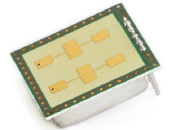

PM4 FS2026: CW-Doppler-Radar Sensor
Project Goals
Design a radar sensor
  start with a standard use case (see below)
  and/or an idea of your own
  document your HW/DSP-concept
Realize your prototype
  Hardware
  Firmware/Software
Test the performance of your prototype
Document and present your prototype
v
radial
velocity
range R
radar sensor
K-LC5
radar sensor
K-LC5

Slide 2
References
General information can be simply found on Wikipedia:
  Distance and Spead Measurement, Radar Range Equation, …
Further technical information can be found on the Radar Tutorial:
  Doppler-Effect (see Figure 1 first)
  CW-Doppler-Radar
  (only sections Doppler Radar, Function, Block diagram of CW radar Figure 3)
  Radar Range Equation
  Radar-Cross-Section
RFbeam, St. Gallen: https://www.rfbeam.ch/
  use cases
  Radar sensor used in PM4:
    Radar Sensor K-LC5 , data sheet K-LC5

Slide 3
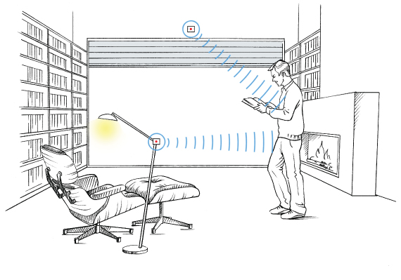
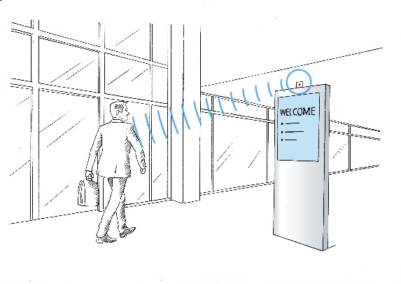
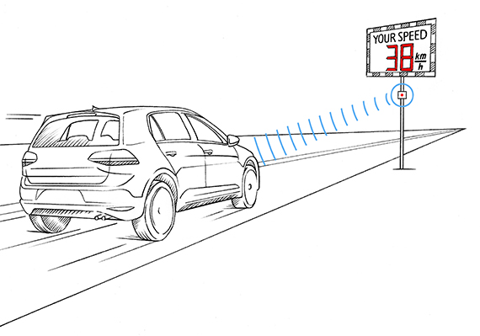
Some use cases
1. CW-Doppler-Radar: motion sensor
- for movement detection
- indoor automation
- intrusion alarm
challenge: human presence detection
2. CW-Doppler-Radar: speed sensor
- traffic monitoring
- sports (challenge: reflectivity of target)
3. FMCW-Radar: range sensor
- please see corresponding document
- range (i.e. distance) measurements
- more challenging than CW-Doppler-Radar
use case 1
use case 1
Source: https://rfbeam.ch/applications/
use case 2

Slide 4

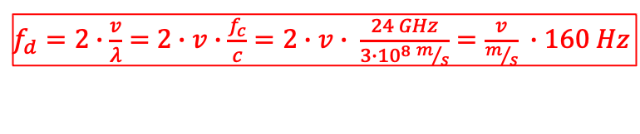
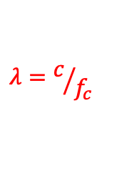
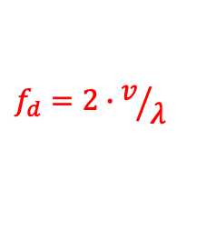
CW-Doppler-Radar: How it works
CW-Doppler-Radar
Doppler-Effect
Doppler-frequency
wave length λ
c: speed of light (~ 3·10⁸ m/s)
f_{c}: transmit frequency ( 24 GHz)
v / (m/s) | v / (km/h) | f_{d} / Hz
0.1 | 0.36 | 16
0.28 | 1 | 44.4
1 | 3.6 | 160
2.8 | 10 | 444
10 | 36 | 1600
28 | 100 | 4444
target
$$f_{d}=2∙v/λ$$
v
radial
velocity
$$λ=c/{f_{c}}$$
range R
$f_{d}=2∙\frac{v}{λ}=$ $2∙v∙\frac{f_{c}}{c}=2∙v∙ \frac{24 GHz}{3∙{10}^{8} m/s}=\frac{v}{m/s} ∙160 Hz$
x(t) = cos(2π·f_{c}·t)
y(t) = A·cos(2π·(f_{c}+f_{d})·t)
(in-phase signal) I(t) = A·cos(2π·f_{d}·t-φ₀)
=> I(t) = y(t)·cos(2π·f_{c}·t) low-pass filtered
cos(2π·f_{c}·t)
(quadrature-phase signal) Q(t) = A·sin(2π·f_{d}·t-φ₀)
=> Q(t) = y(t)·(-sin(2π·f_{c}·t)) low-pass filtered
CW-Doppler-Radar: DC to set f_{c}
(should be different to avoid interference between sensors)
FMCW-Radar: sawtooth
(DAC with reconstruction filter)
= f_{c}
VCO: voltage controlled oscillator
LNA: Low Noise Amplifier

Slide 5
Review of Fourier Theory
Frequency translation
x(t) = y(t) · e^{j2πfc·t} ○-● X(f) = Y(f-f_{c})
multiplication with e^{j2πfc·t} ○-● frequency translation with +f_{c} (to the right)
cos(ω_{c}·t) = (e^{j·ωc·t} + e^{-j·ωc·t}) / 2
Euler-formula:
Multiplication of the received signal y(t) with cos(2π·f_{c}·t)
causes a frequency translation by ±f_{c} (see the following spectra)
IY(f)I
f_{c} - f_{Doppler}
target moves away from the radar sensor (v<0)
and causes a negative Doppler frequency
f
f_{c}
-f_{c}
+f_{c}
-f_{c}
+f_{c}
II(f)I
X
X
filtered
f
f_{Doppler}
f_{c}

Slide 6
Exercise 1
Assume that the target moves towards the radar sensor (v>0)
and, thus, causes a positive Doppler frequency (f_{d}>0)
In the following diagram, sketch the magnitude spectra
IY(f)I of the reflected radar signal y(t) and
II(f)I of the analog radar-sensor output signal I(t)
IY(f)I
f
f_{c}
II(f)I
f
f_{d}
f_{c}
Please verify that the sign of the Doppler frequency f_{d} and the velocity v and, hence,
the direction of the movement can not be distinguished if only 1 sensor output signal is used !

Slide 7
FFT-based Doppler frequency detection
Review of FFT
The FFT transforms N samples in the time-period [0,…,NT_{s}) into
N uniformly distributed (complex) spectral-values in the range [0,…,f_{s}).
Spectrum of analog radar sensor output signal I(t)
II(f)I
f_{s}/2
X
X
filtered
f
f_{d}
f_{c}
FFT-spectrum of the sampled radar sensor output signal I[n] = I(t=nT_{s})
(f_{s} is the sampling frequency)
Zero-frequency component shifted to
center of spectrum (Matlab: fftshift)
II[m]I
f_{d}
f_{s}-f_{d}
-f_{d}
f_{d}
FFT
fftshift
f
f
f_{s}
f_{s}/2

Slide 8
Determination of movement direction
Multiplication with e^{-j2πfc·t} ○-● frequency translation with -f_{c} (to the left)
Euler: e^{-jφ} = cos(φ) - j·sin(φ)
y(t)·e^{-j2πfc·t} = y(t)·[ cos(2πf_{c}·t) - j·sin(2πf_{c}·t) ] = I(t) + j·Q(t)
e^{-j...}
complex-valued signal Z(t)
IY(f)I
f_{c}-f_{d}
f
IZ(f)I
f_{c}
-f_{c}
-f_{c}
filtered
X
f
-f_{d}
f_{s}/2
f_{c}
FFT-spectrum of the sampled radar-sensor output signal z[n] = I[n]+j·Q[n]
IZ[m]I
IZ[m]I
f_{s}-f_{d}
-f_{d}
FFT
f
fftshift
f
f_{s}
f_{s}/2

Slide 9
Exercise 2
Assume that the target moves towards the radar sensor (v>0)
and, thus, causes a positive Doppler frequency (f_{d}>0)
In the following diagram, sketch the magnitude spectra
IY(f)I of the reflected radar signal y(t) and
IZ(f)I of the analog radar sensor output signal z(t) = I(t)+j·Q(t)
IZ[m]I of the sampled radar-sensor output signal z[n] = I[n]+jQ[n]
IY(f)I
f
IZ(f)I
f_{c}
f
f_{s}/2
f_{c}
IZ[m]I
IZ[m]I
FFT
f
fftshift
f
f_{s}
f_{s}/2

Slide 10
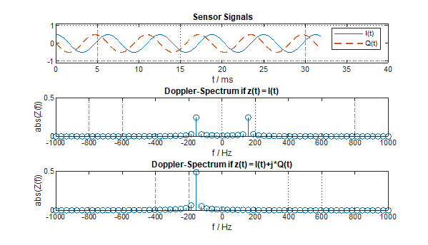
Exercise 3
Use the Matlab-program CW_Doppler_Radar_8kSps_160.m, read
the corresponding wave-file and determine the Doppler-frequency f_{d} and
the resulting radial (Doppler-) velocity v. The result should look like this:
f_{s} = 8 kSps
N_{FFT} = 256
T_{FFT} = N∙T_{s} = 32 ms
Δf = 1/T_{FFT} = f_{s}/N ≈ 31 Hz
detected f_{d} = -156.3 Hz
(instead of -160 Hz)
detected radial velocity
v = -0.98 m/s (away from
the radar, instead -1 m/s)
test also with N_{FFT} = 64
direction of movement cannot be determined!
f_{d} is negativ
(movement away from the radar)

Slide 11
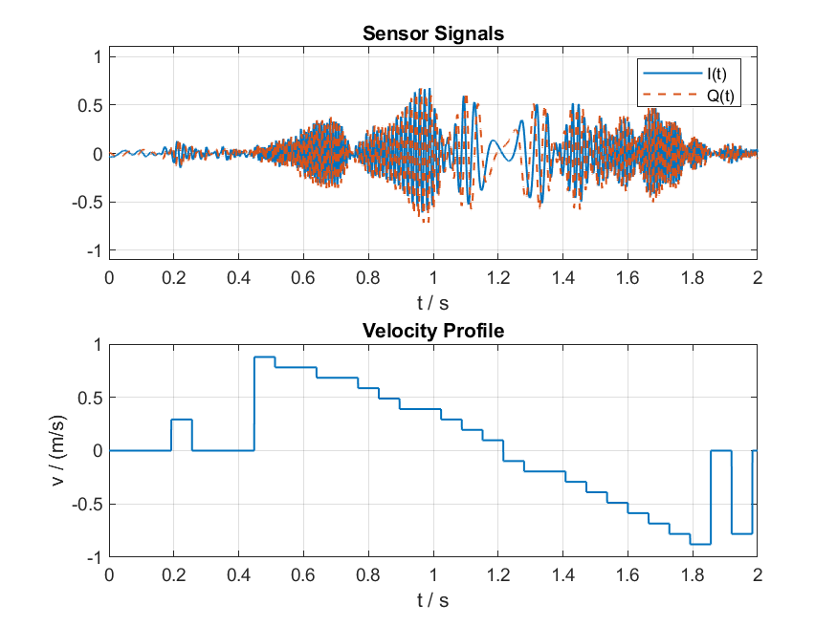
Exercise 4
Use the Matlab-program CW_Doppler_Radar_4kSps_waveByhand.m read
the corresponding wave-file and determine the resulting Doppler-velocity-profile
v(t). The result should look like this:
f_{s} = 4 kSps
N_{FFT} = 256
T_{FFT} = N∙T_{s} = 64 ms
Δf = 1/T_{FFT} = f_{s}/N ≈ 15.6 Hz
the hand was moved first towards the
sensor and then away from the sensor
signal level below threshold

Slide 12
DSP-Design-Scenario
Speed sensor: moving car, max. range 40-60 m (see below)
v_{max} = 80 km/h
Doppler frequency f_{d} = ± 3556 Hz
sampling frequency f_{s} = 8 kSps is larger than 2∙If_{d}I
block length N = 256
measurement time T_{FFT} = N∙T_{s} = 32 ms (car moves < 0.7m during this time)
FFT frequency resolution Δf = 1/ T_{FFT} ≈ 31 Hz (corresponds to 0.7 km/h)
accuracy of the speed indication is ±0.35 km/h

Slide 13



Link Budget
K-LC5 data sheet
Radar Cross Section
(σ ≈ 1 m² for moving person
σ ≈ 50 m² for moving car)
Effective Isotropic Radiated Power
EIRP = 12 dBm
G_{antenna} = 8 dB
4 dBm
Round-trip loss S ≤ 117 dB = 12 - (-105)
(Datasheet: overall sensitivity = -118 dBc)
Range R
G_{LNA} = 10 dB
Radar Range Equation @ 24 GHz
R = 0.0167 · 10^{S/40} · σ^{0.25}
(S in dB and σ in m²)
P_{out}
≥ -87 dBm
G_{antenna} = 8 dB
Sensitivity
P_{Rx} ≥ -105 dBm (B=1kHz, S/N=6dB,...)
Exercise 5: Compute the maximum (detection) range R of the CW-Doppler-Radar
for a moving person:
for a moving car:

Slide 14
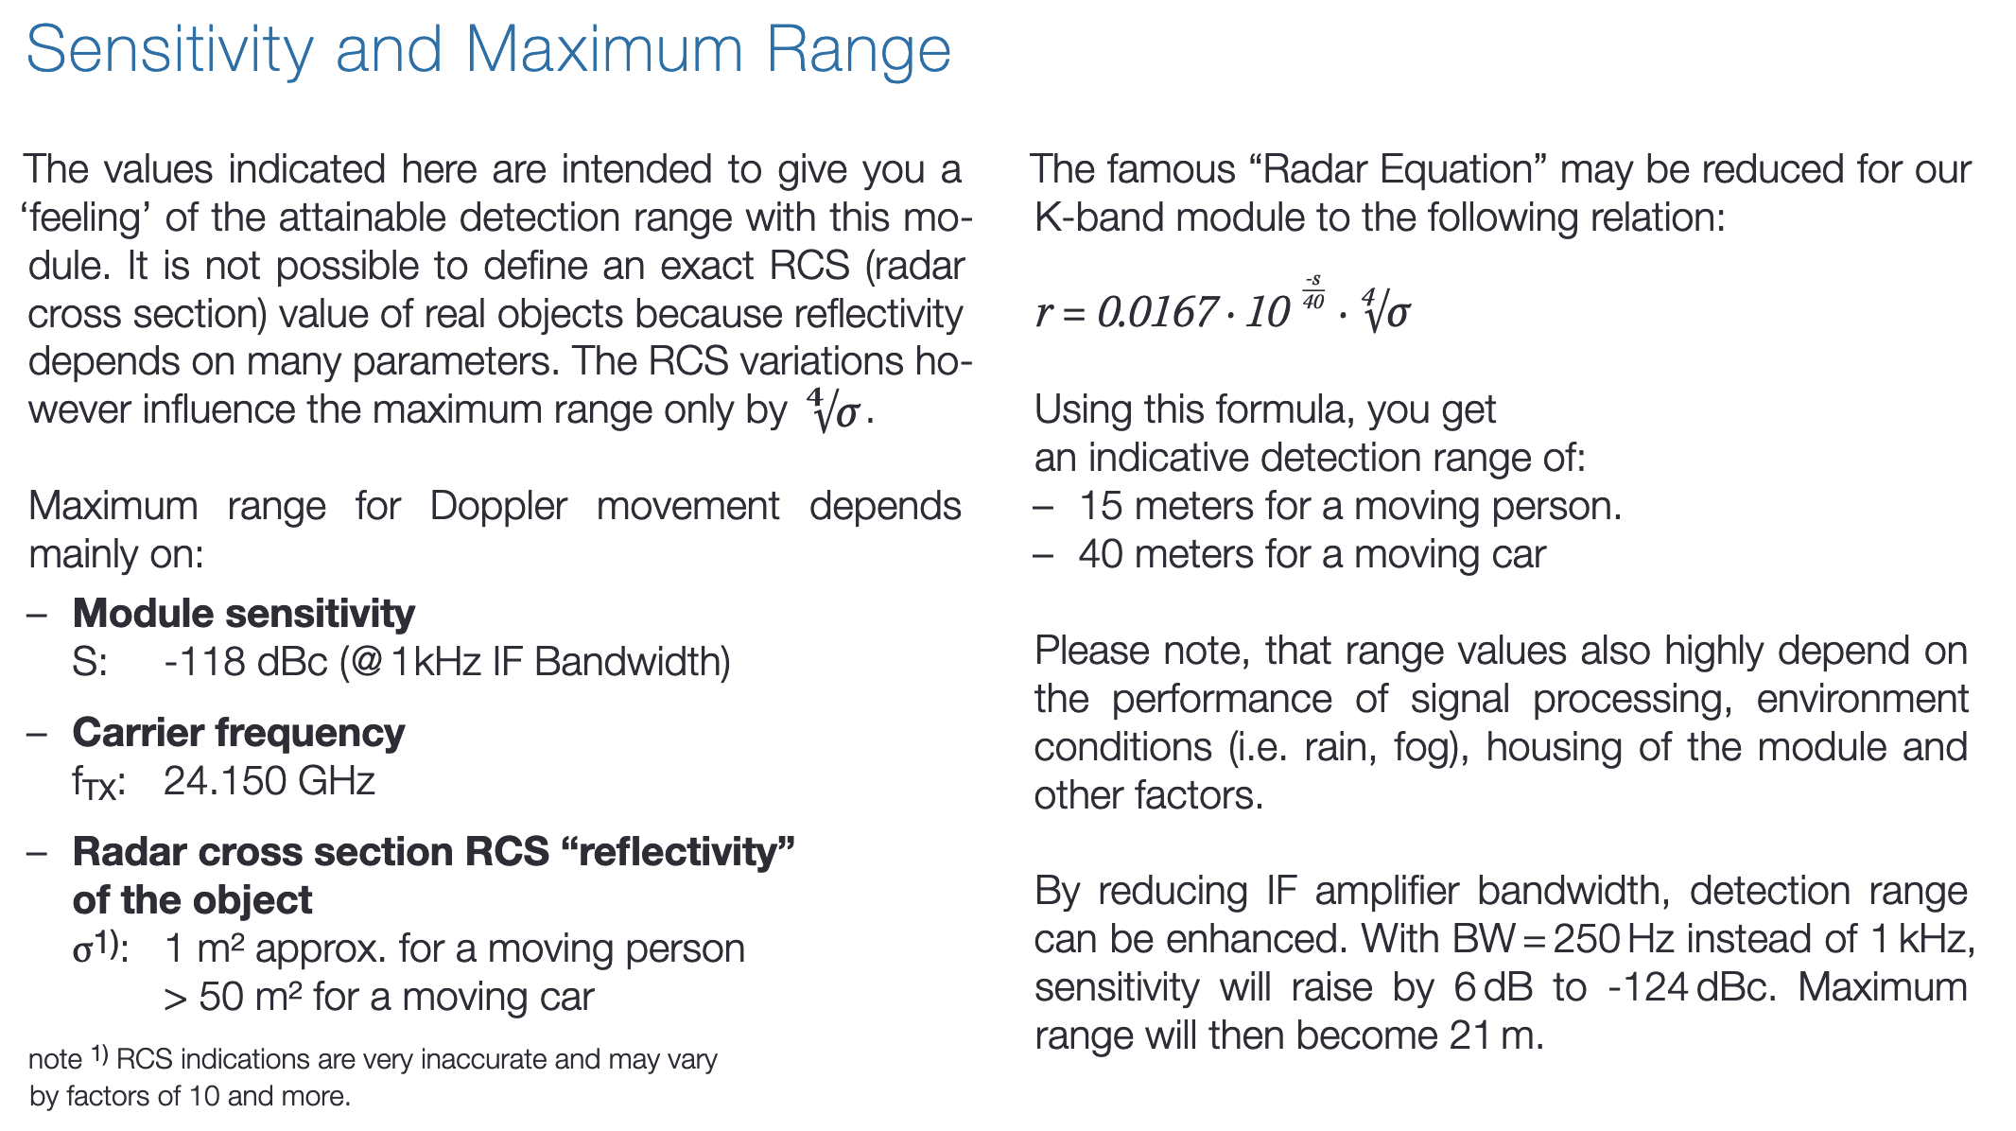
Detection Range
K-LC5 data sheet
RCS

Slide 15
Gain of external amplifier
Parameter | Value | Remarks
Sensitivity K-LC5 | -105 dBm | e.g. moving person @ a range of 14 m
receiver gain | 18 dB | see data sheet K-LC5
min. P_{out} | -87 dBm | @ R = 1 kΩ output of LNA
P_{out} in mW: 10·log₁₀(P_{out}/1mW) ≥ -87 dBm => P_{out} ≥ 10^{-8.7} mW
V_{out, rms} in V: √(R*P_{out}) => V_{out, rms} ≥ 10^{-8.7/2} V = 45 μV => V_{out} ≥ 64 μV
But: the 12 Bit ADC has a dynamic range ≈ 3V, i.e. an LSB of 732 μV!
therefore, an external gain amplifier is required: V_{ADC} = V_{out}·G_{amp}
with G_{amp} = 60 dB, i.e. G_{amp} = 1000: V_{ADC} ≥ 64 mV, i.e. at least 6 LSBs
AC-coupling is required for such a (high) gain, but the high-pass-filter
removes the low frequencies and, thus, the small v-values.
There is a minimal detectable speed v_{min} > 0

Slide 16
Gain of external amplifier
Assumption:
a moving person is in short distance (3m) directly in front of the sensor
Exercise 6:
Fill out the column «values» of the following table and verify, that
a «large» received signal does not over-drive the ADC (no clipping).
Parameter | Values | Remarks
EIRP | 12 dBm | effective isotropic radiated power
Round-trip-loss | dB | see slide 13, R = 3 m, RCS = 1 m²
received power P_{Rx} | dBm | see slide 13
receiver gain | dB | see slide 13
max. P_{out} | dBm | @ R = 1 kΩ output of LNA
max. P_{out} | mW | @ R = 1 kΩ output of LNA
max. V_{out} | mV | @ output of radar sensor
max. V_{ADC} | V | 60 dB external gain

Slide 17
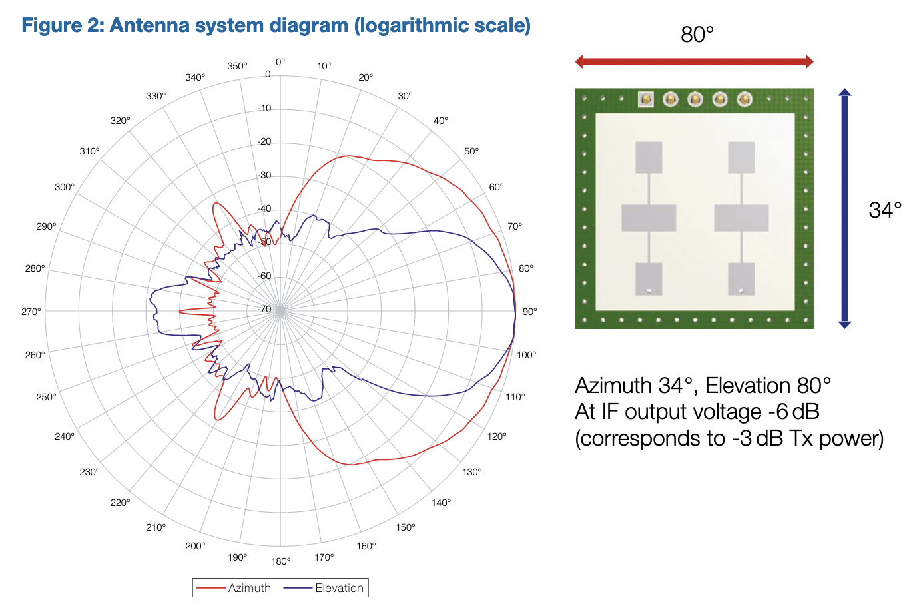
Radar-Sensor
    Radar Sensor K-LC5
    data sheet K-LC5
Field-Of-View: 80°x34°
6 m
16.8 m (@ r=10m)
K-LC5
Overall S = 118 dBc (B=1kHz, S/N=6dB, ...)
R_{max} moving person ≈ 15 m
Sensitivity: -105 dBm (B=1kHz, S/N=6dB,...)
Rx gain: 18 dB
FMCW supported
3.3V version ordered
(Digikey, K-LC5-RFB-00C, CHF 25.-/pcs)

Slide 18
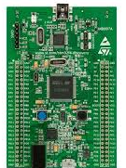
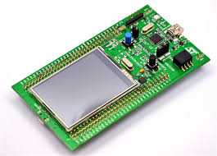
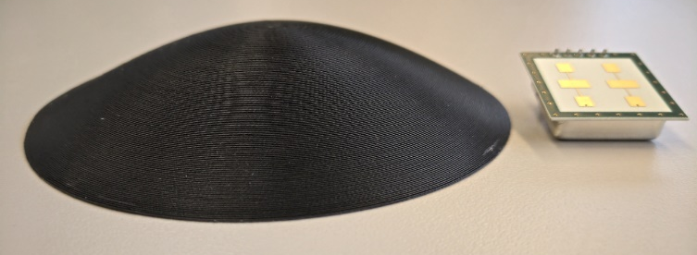
CW-Doppler-Radar: Hardware
MCU board
radar sensor K-LC5
3.3V power supply
amplifier (60 dB)
for I- and Q-output
highpass,
VCO in (DAC)
test points
LED?, switch?, buzzer?
filter analog 5V power supply
USB power supply
STM32F4-Discovery-Board
Option: 3D-printed lens for focussing
Sensor board
a PCB-template is available

Slide 19
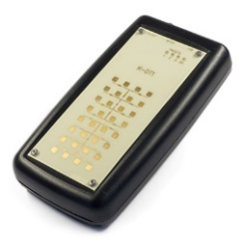
Subsystem Test Scenarios
1. Sensor-Board without radar sensor K-LC5 and without MCU-board
Function Generator (sin, 100 Hz…4 kHz, 50 μV…1 mV) at I-/Q-connector pins
validate the external amplifier outputs with the oscilloscope (in front of ADC)
check also the magnitude frequency response
2. Sensor-Board with radar sensor K-LC5 and without MCU-board
put the Radar Doppler Target K-DT1 in front of the radar sensor
validate the external amplifier outputs with the oscilloscope (in front of ADC)
3. MCU-Board with FFT-firmware and without radar sensor board
FuGe (sin, 100 Hz…4 kHz, 50 mV…1V, 1.5V DC-offset) at ADC inputs
show and validate frequency on the display

